Slide 1




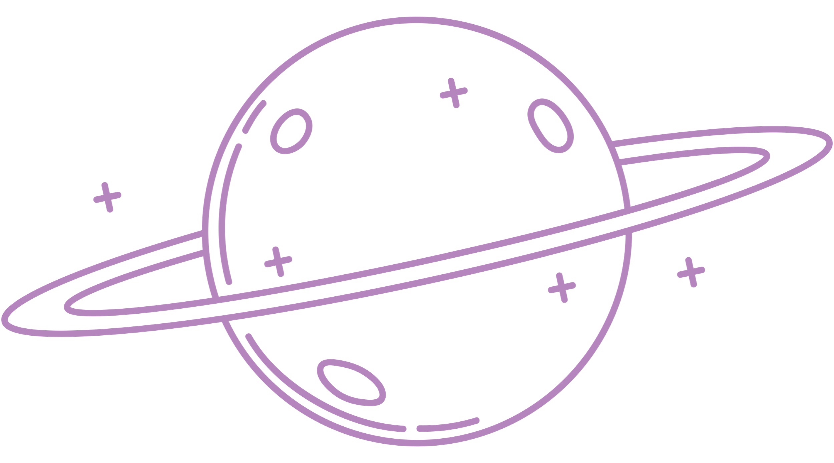





DISCOVER AI
ALYA
with
Is AI good or bad?
Can robots
have
emotions?
by Dr Yasemin Allsop

Slide 2
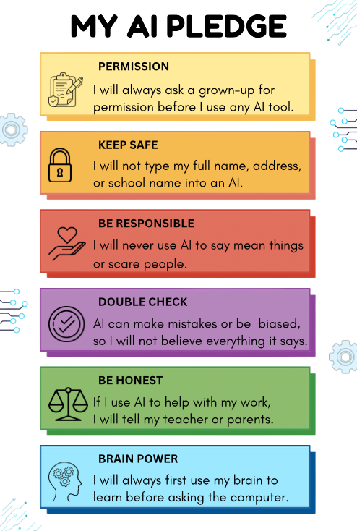

Why is it important
to use our 'Brain Power'
before asking a computer?

Slide 3
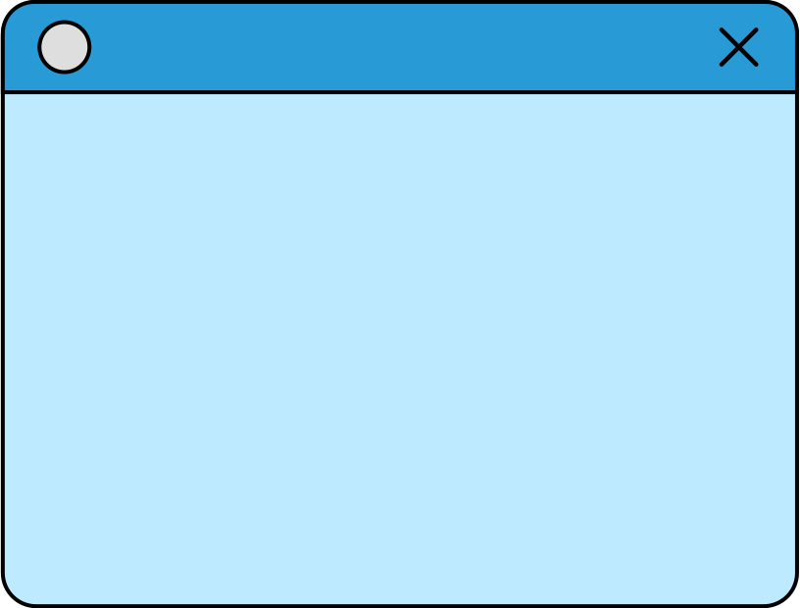
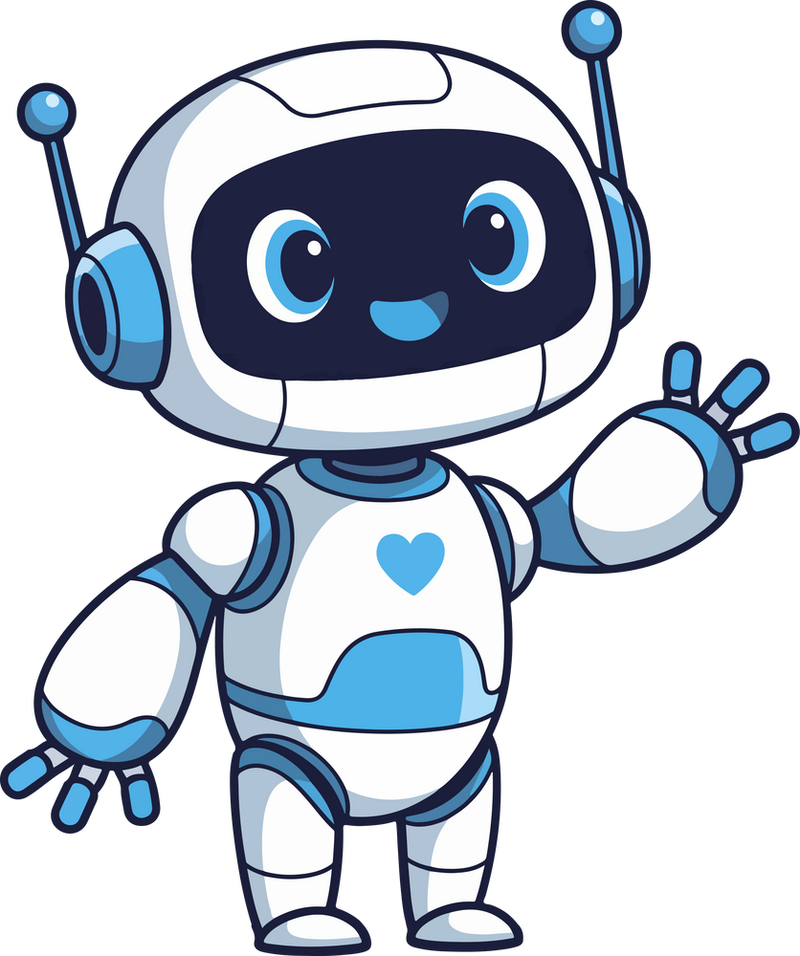
WHAT IS AI?
Artificial Intelligence (AI) is a special kind of computer program that teaches computers to learn, listen, and make decisions like humans do.

Slide 4
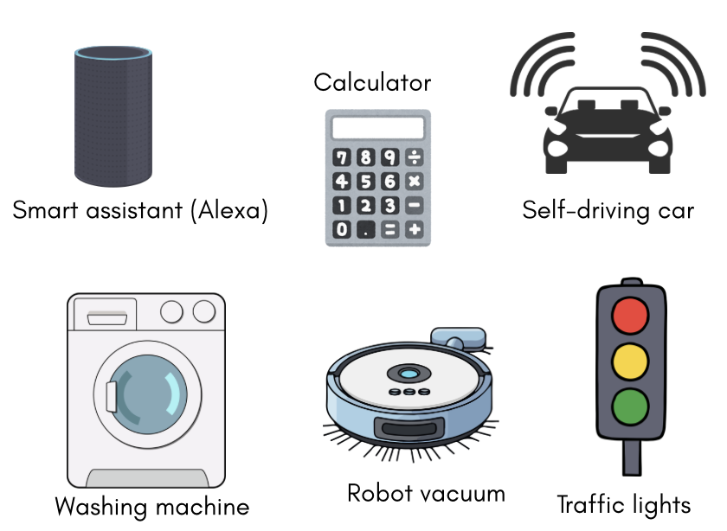
AI OR
NOT AI?

Slide 5


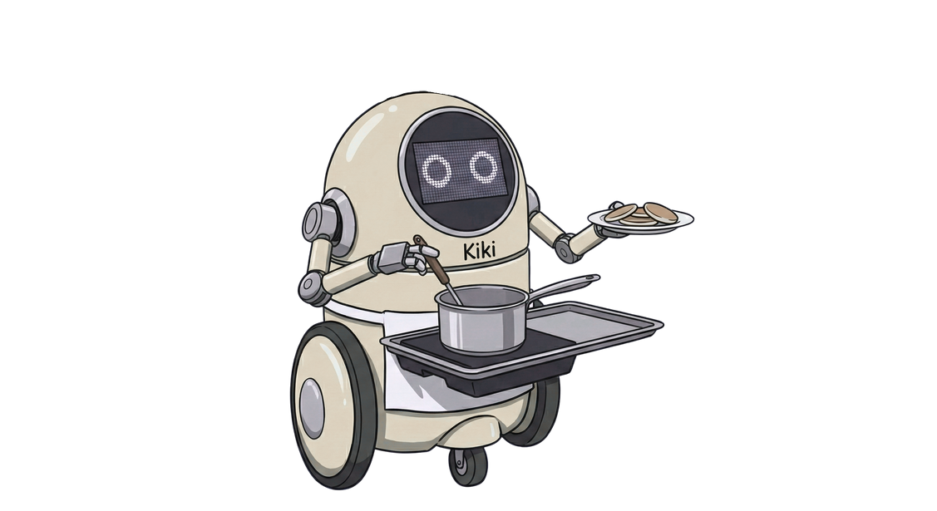
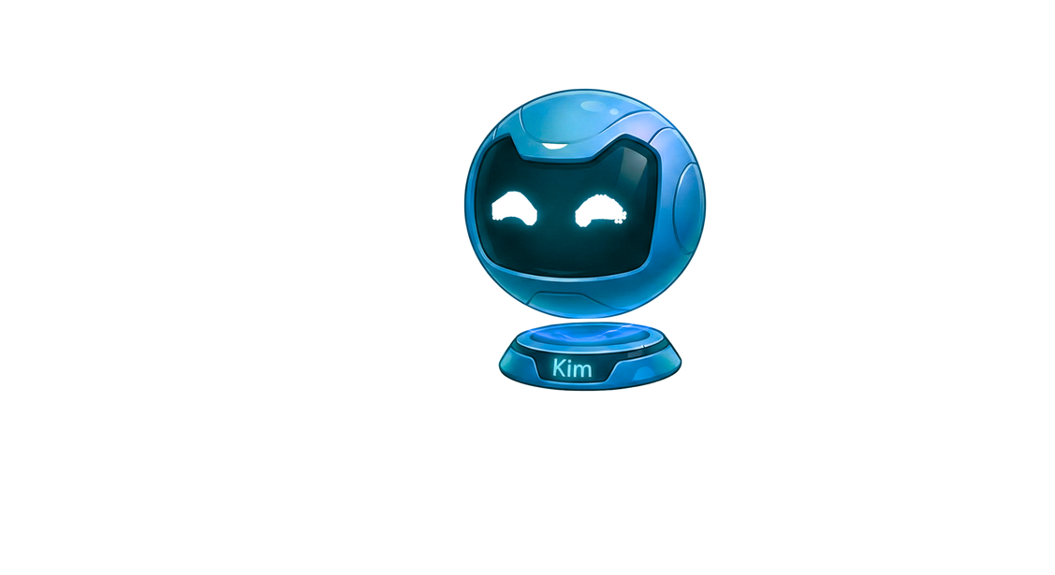
WEAK AI
STRONG AI
Weak AI is a computer program or robot that is super good at specific things. Siri, Alexa, Google Maps and robot vacuum are all Weak AI.
Strong AI is a robot that can learn anything it wants to. It can make its own decisions. Scientists are still trying to figure out how to build it.
KIKI
KIM

Slide 6

IS A TOASTER AN AI?

Slide 7
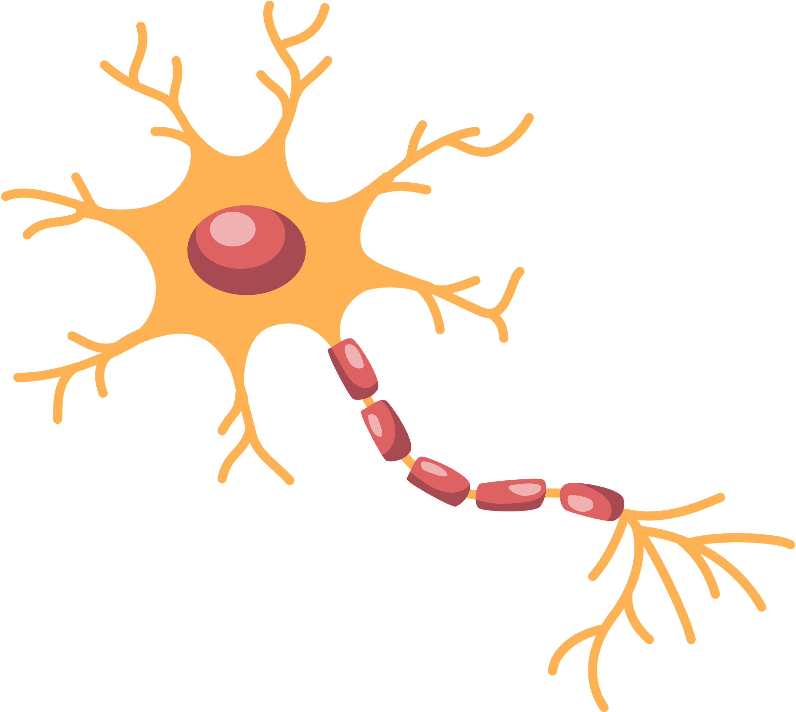
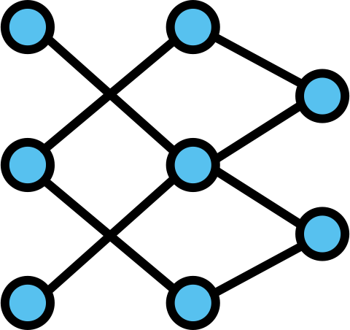
ARTIFICIAL NEURAL NETWORK
NEURON
A neuron is a tiny cell in your brain.
Neurons send messages to each other. They help you:
    Think
    Learn
    Decide what to do
Your brain has billions of neurons working together!
It is a computer brain.
It is inspired by human brain neurons. Made of many small connected parts, like brain cells.
It helps computers:
    Recognise pictures
    Understand words
    Make smart choices

Slide 8
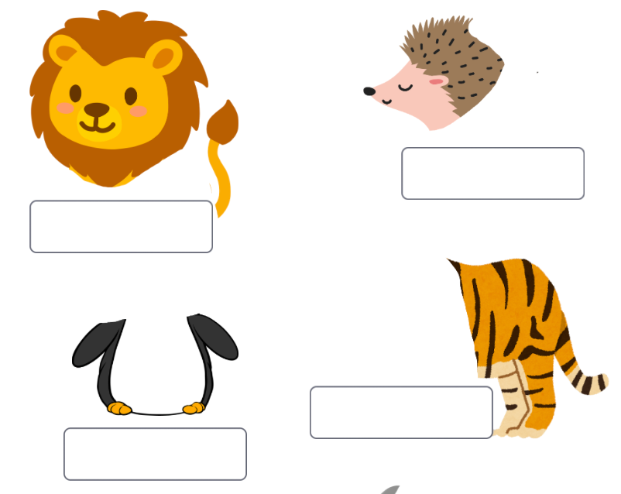
CAN YOU RECOGNISE THE ANIMALS BELOW?

Slide 9
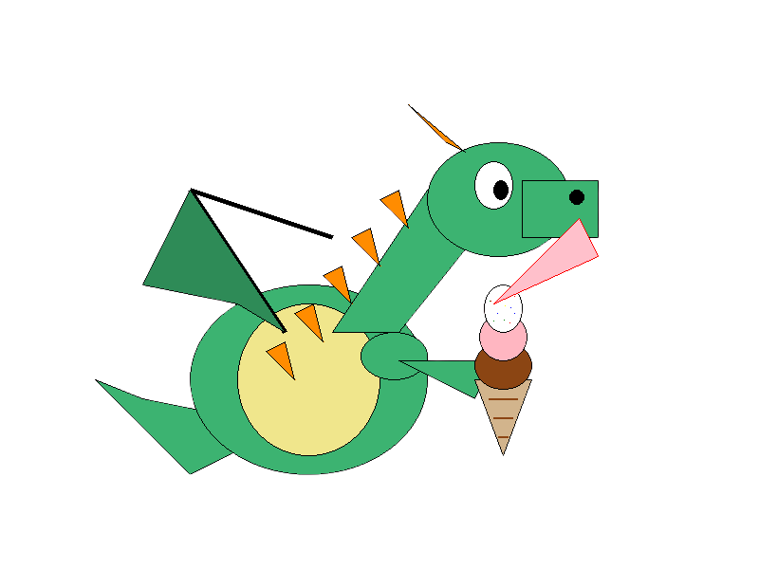
HOW AI REMIXES?

Slide 10
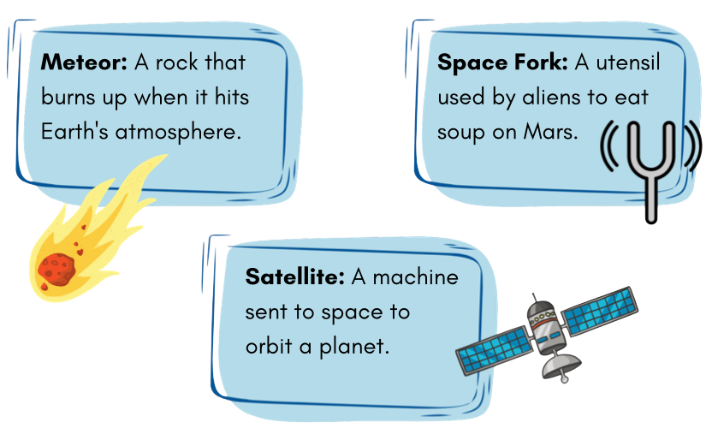
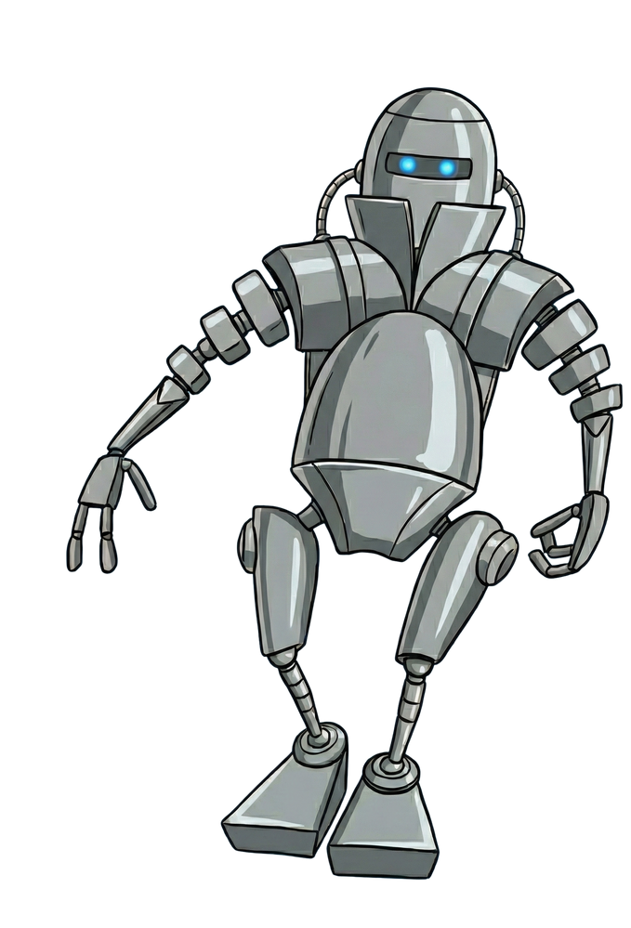
WHICH ONE IS FAKE?
The AKI robot found three items. It used its Generative AI to write descriptions. Two are real space facts, but one is a Hallucination. Can you spot the fake?

Slide 11
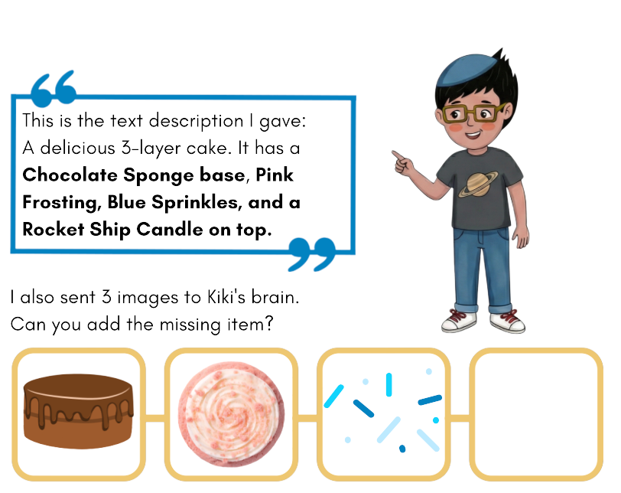
MISSING
DATA

Slide 12
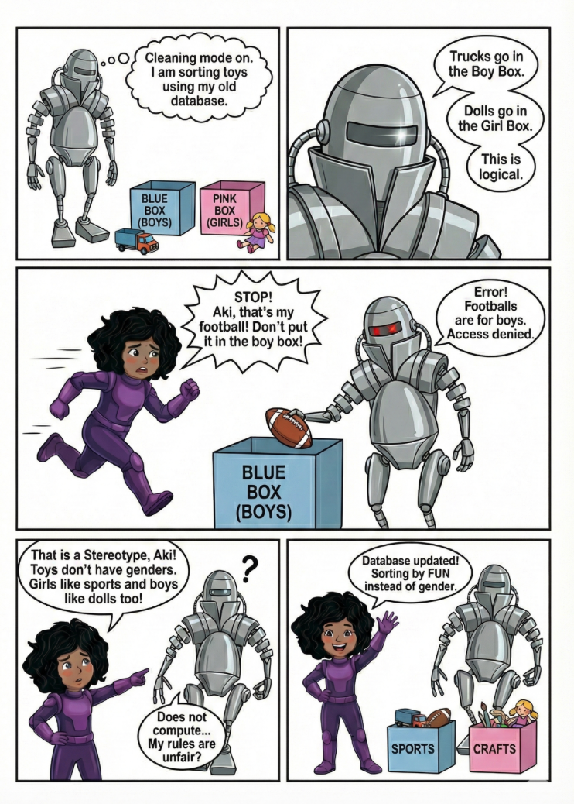
SPOT THE BIAS

Slide 13
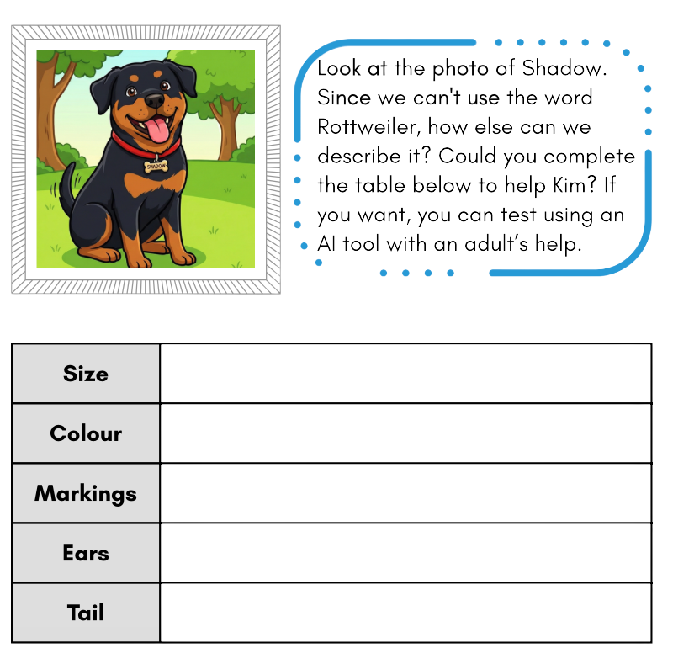

THE PROMPT
DETECTIVE
Alya wants Kim to draw a picture of her dog, Shadow. But Kim’s Dog Breed Database has
been deleted! It doesn't know what the word Rottweiler means anymore.

Slide 14
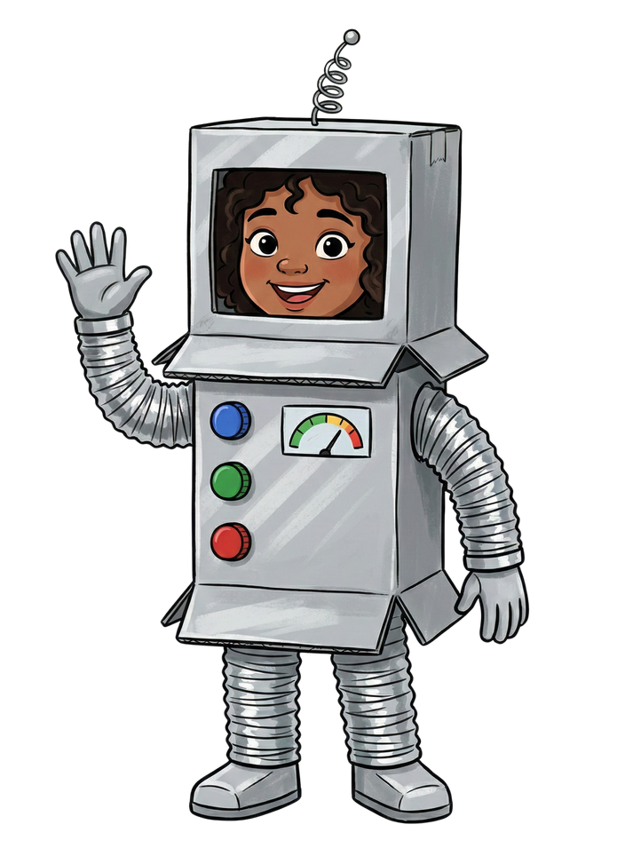

THANK YOU
Yasemin Allsop, 2026. Based on characters from Alya the Pathmaker.

